Slide 1
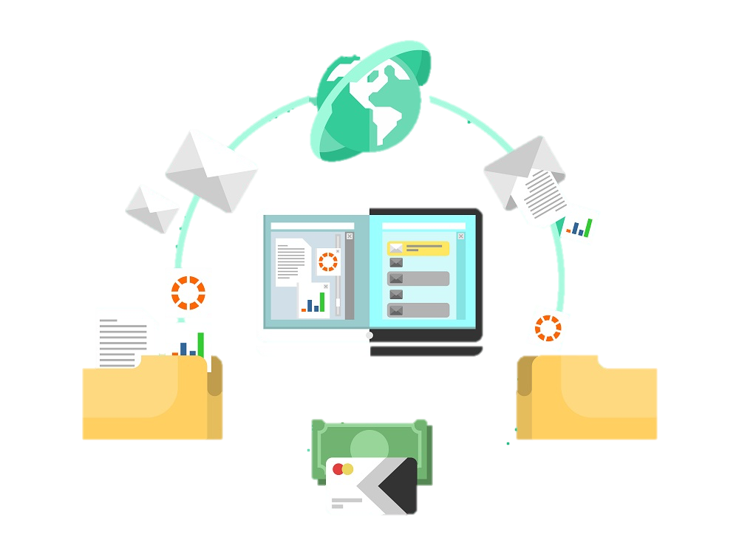
MEASURING OBSERVABLE INFLUENCE
AND IMPACT OF
SCIENTIFIC RESEARCH
BEYOND ACADEMIA

Slide 2
INTRODUCTION
GOAL and MOTIVATION
SCHEDULE
PROGRESS
CHALLENGES
NEXT STEPS
AGENDA

Slide 3
INTRODUCTION

Slide 4
Since 2001, Genome British Columbia has been investing in life science research in BC to address challenges in key sectors such as health, forestry, fisheries, aquaculture, agri-food, energy, mining, and environment.
As part of Genome BC’s efforts to measure the impact of their funded research and demonstrate accountability to the stakeholders, we would like to identify how academic publications generated by funded research projects, translate to real world impacts.
Notes:
Genome bc pic

Slide 5
OVERVIEW

Slide 6
GOAL
MOTIVATION
The goal of this project is to create a system that automates the process of matching academic publications that have arisen from Genome BC funded projects, to publicly available downstream documents.
We need to assess whether the academic outcome had any influence in decision making.
Checking the impact of research publication in Healthcare for future implementation.
Make healthcare research more impactful and beneficial to people.
Help researchers understand the real world impacts of healthcare publications.
Notes:
Goal and motivation target type pc

Slide 7
IMPACT

Slide 8
WE HAVE THE RELATIONSHIP BETWEEN THE PUBLISHED ARTICLES AND DOWNSTREAM DOCUMENTS.
HOW THIS RELATIONSHIP AFFECTS THE NEW RESEARCHWORK AND APPLICATION.

Slide 9
SCHEDULE

Slide 10
FEB 18
MAR 11
MAR 16
FEB 24
MAR 4
MAR 20
MAR 27
APR 2
APR 4
APR 8
APR 14
FINAL REPORT
+
VIDEO
EDA ON
CLIENT’S DATA
ANALYZING REF IN DATABASE
PROPOSAL
PRESENTATION
VISUALIZATION
DATA COLLECTION
+
SCRAPPING
EXTRACTING REFERENCES USING NLP
FINAL ANALYSIS
POSTER PRESENTATION
DATABASE COMPLETION
+
CLEANING

Slide 11
PROGRESS

Slide 12
DATA ACQUISITION
DATA FROM 5 DIFFERENT SOURCES
LAYERED DATA ON EVERY WEBSITE WITH SEVERAL LINKS IN EACH
EACH LINK HAS FURTHER LAYERS TO GET DATA FROM!!!
MANUALLY DOWNLOADING UNSTRUCTURED DATA
USING TOOLS LEARNED TO SCRAP THE REFERENCES FROM THE DATA.

Slide 13
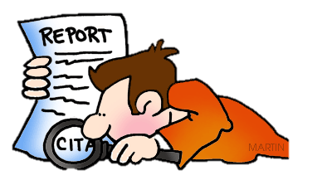
WEB SCRAPING
CRAWLING THE WEBSITES TO DOWNLOAD THE PDFs (UNSTRUCTURED) TO GET THE REFERENCES.
SCRAP AND STORE THE PDFs AVAILABLE RELATED TO RESEARCH IN DISEASES
SCRAPY (a powerful tool for scraping) USED TO GET REQUIRED DOCS.

Slide 14
NEXT STEPS
EXTRACTING REFERENCES TO BUILD THE DATABASE
USING NLP TO GET CORRECT KEYWORDS
EDA ON GENOME BC’s DATA
GETTING IMPACTS FROM EACH PUBLICATION USING ANALYSIS
VISUALIZATION USING TABLEAU
AUTOMATE SCRAPING PROCESS TO TEST
Notes:
Nlp,automation,visualization

Slide 15
APPROACH

Slide 16
CHALLENGES

Slide 17
THE BIGGEST CHALLENGE IS TO GET DOWNSTREAM DOCUMENTS BY SEARCHING URL AND PDF. THE WEBSITES HAVE A LAYERED APPROACH BECAUSE OF WHICH IT FORMS A TREE LIKE STRUCTURE FOR DOCUMENTS.
TRADITIONALLY, THE METHOD TO GET TO THIS LAYERED APPROACH IS BY GOING TO URL. WE ARE TRYING TO APPROACH THIS BY GIVING URL AND PDF BY GENERATING SOME QUERY.
CRAWLING IS A TEDIOUS TASK FOR EVERY LINK AS THE HTML STRUCTURE IS COMPLETELY DIFFERENT.
DATA IS NOT CONSISTENT AND REFERENCE FORMATS ARE DIFFERENT EVEN IN THE SAME WEBSITE.

Slide 18
QUESTIONS?
Notes:
questions

